Slide 1

MSB4182
SOCIAL ENTREPRENEURSHIP
Lesson 1
ENTREPRENEURSHIP
STYLE

Slide 2
STYLES OF ENTREPRENEURSHIP
How are they evolved?
Circumstances
Opportunities
Strength
Personality traits

Slide 3
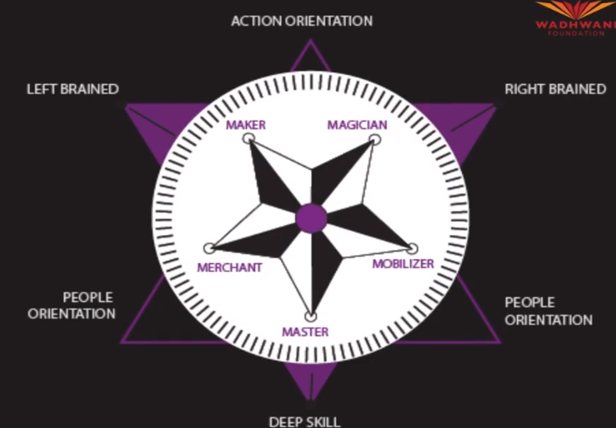
STYLES OF ENTREPRENEURSHIP – 5 types
Maker
Magician
Merchant
Mobiliser
Master

Slide 4

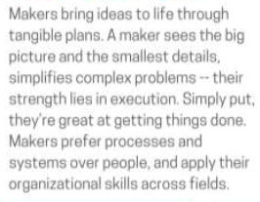





STYLES OF ENTREPRENEURSHIP – MAKER
E.g. NARAYANA MURTHY – FOUNDER OF INFOSYS

Slide 5

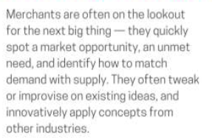




STYLES OF ENTREPRENEURSHIP – MERCHANT
E.g. KISHORE BIYANI – FOUNDER OF FUTURE GROUP

Slide 6

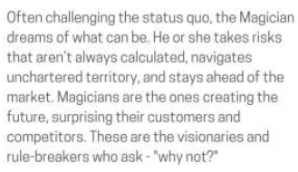







STYLES OF ENTREPRENEURSHIP – MAGICAN
E.g. STEVE JOBS – FOUNDER OF APPLE & PIXAR

Slide 7

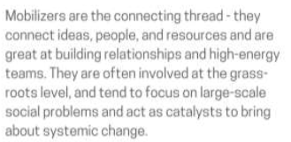



STYLES OF ENTREPRENEURSHIP – MOBILISER
E.g. VERGESE KURIEN– FOUNDER OF AMUL

Slide 8

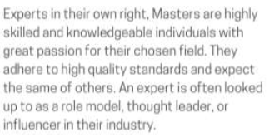



STYLES OF ENTREPRENEURSHIP – MASTER
E.g. Bill Gates – FOUNDER OF MS

